Slide 1
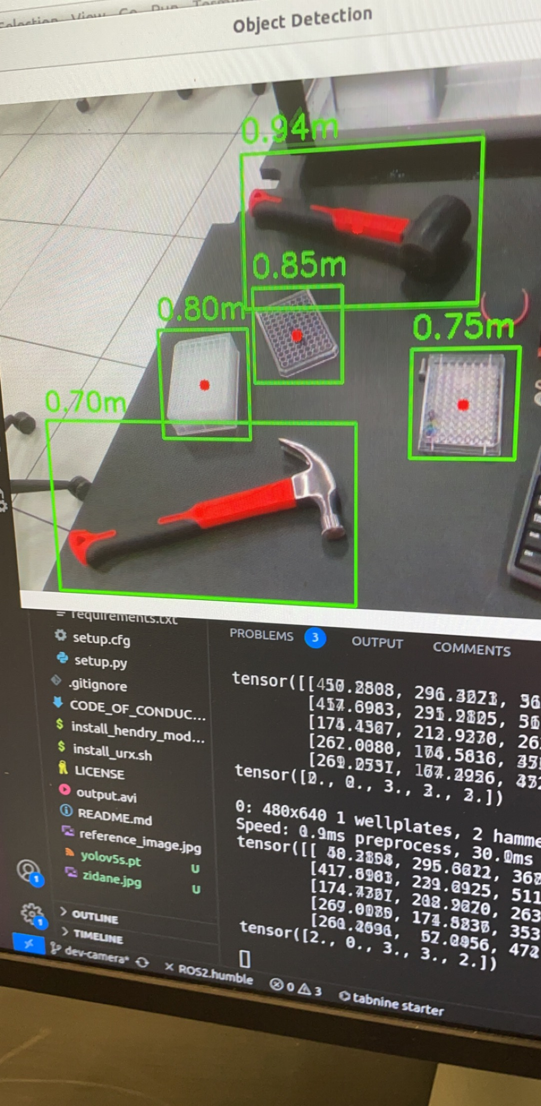
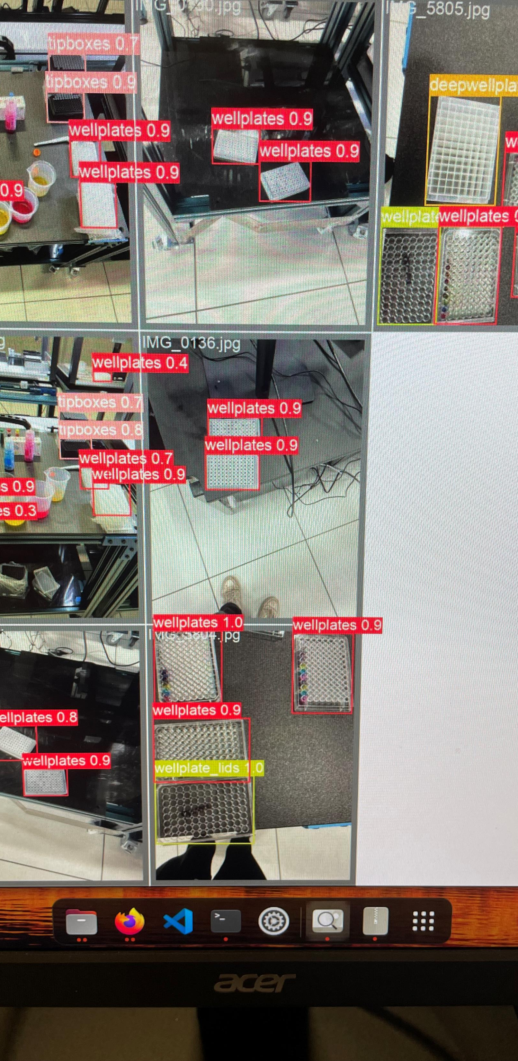
Updates:
-Model Integration; real time recognition
-Accuracy Improvement(85-90% non-complex)
-Distance Measurement
-Display of center of frame and object
Future Goals:
-Improve accuracy and objects within list
-Collaborate code between arm and Camera
-Create a function that calls arm to move to offset of center frames and tower over

